Slide 1

PY03: NumPy

Slide 2
Workshop / Timing Overview
What is NumPy?
Why bother with NumPy?
Importing and downloading NumPy
Making NumPy arrays
Python Lists vs NumPy arrays
Slicing
Mathematical Operations
Useful Functions
Redefining array variables
Random Numbers
In PowerPoint (5 mins)
In Jupyter Notebook (25 mins)

Slide 3
What is NumPy?
NumPy (Numerical Python) is a Python library that’s mainly used for working with arrays, as well as having functions that help us work with linear algebra and matrices.
NumPy arrays are faster, and have loads of supporting functions which make doing Data Science very easy!
NumPy’s main function is the n-dimensional array, which is absolutely fundamental for a data scientist to use and understand.

Slide 4
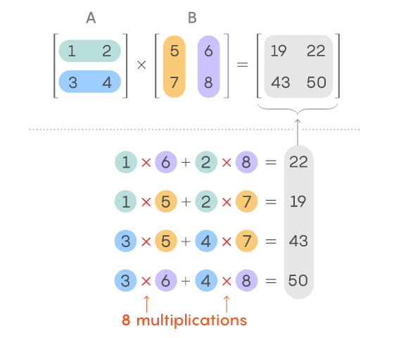
Why bother with NumPy?
If anyone is familiar with matrices, they know that it takes a lot of time multiplying out a 3x3 matrix
Now imagine huge matrices of data with thousands of rows and columns, you’re not gonna do that by hand!

